Slide 1
Introduction to linear regression

Slide 2
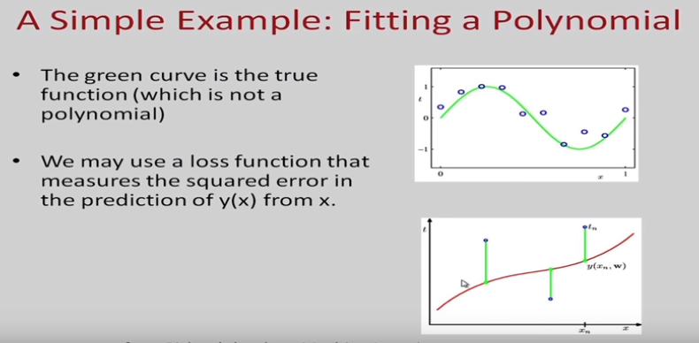

Slide 3
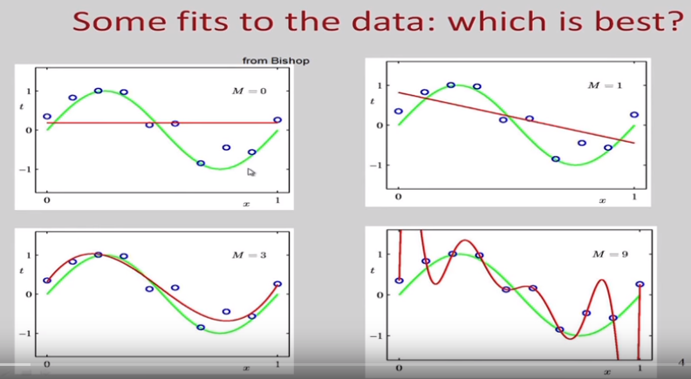



Slide 4
Defnition of regression
Regression analysis is the process of constructing a mathematical model or function that can be used to predict or determine one variable by another variable or variables.

Slide 5
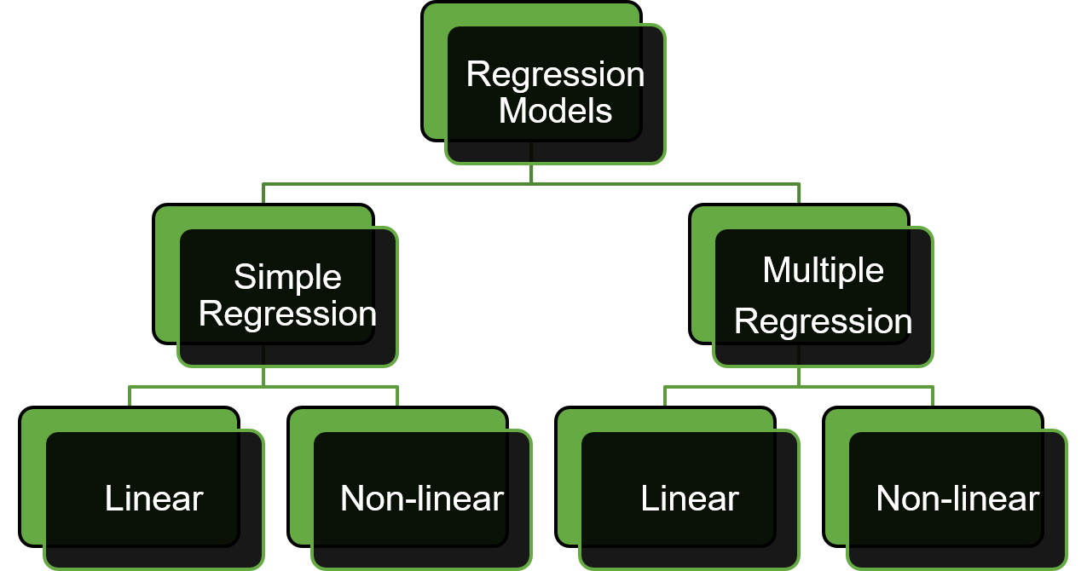
Types Of Regression
One independent variable
More than one independent variable

Slide 6
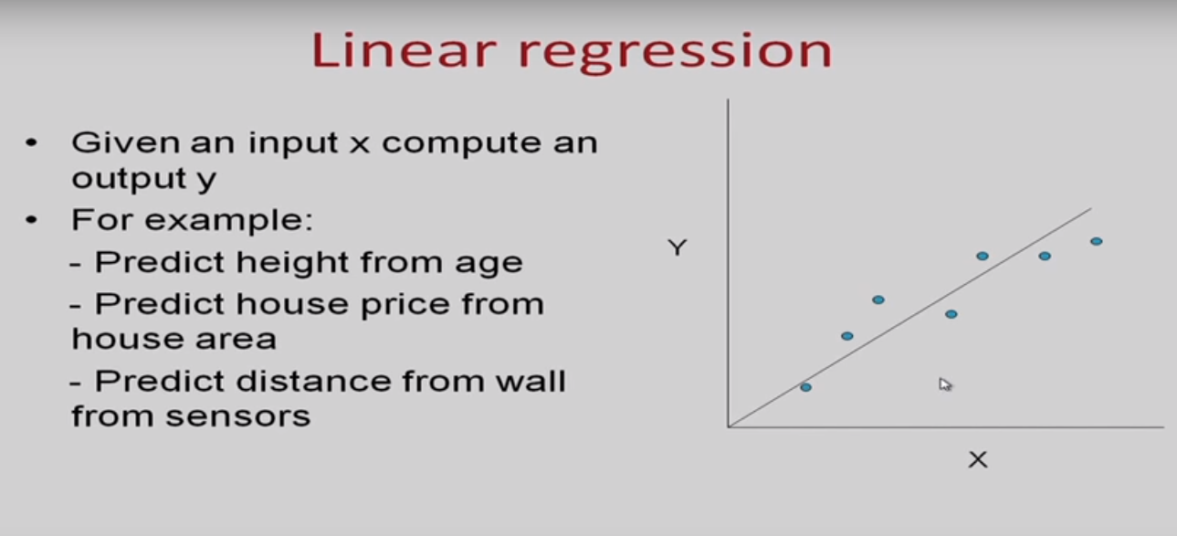





Slide 7
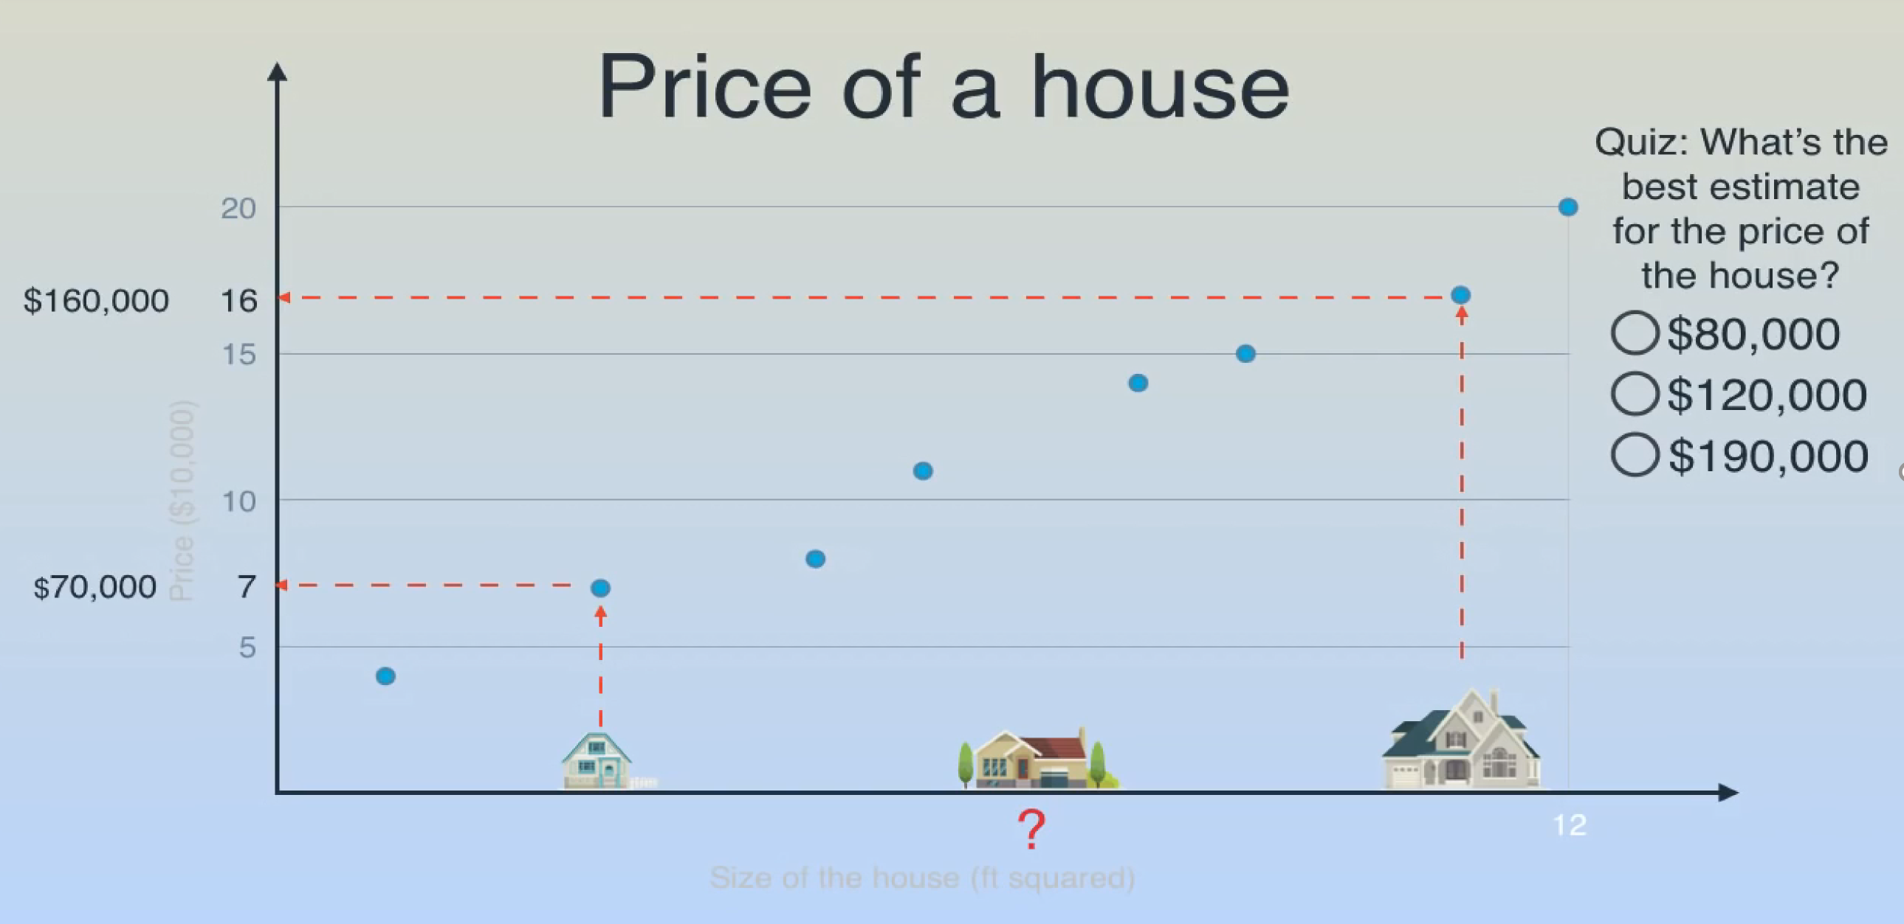
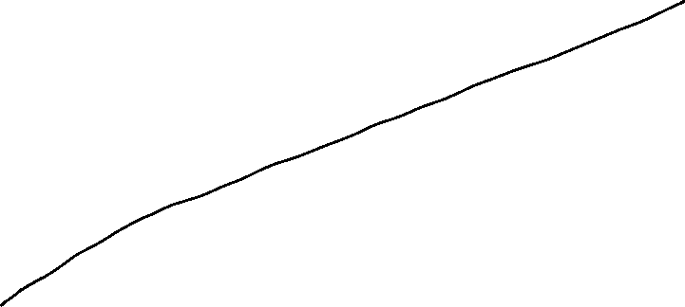

Slide 8
Linear Regression
Linear regression is a simple approach to supervised learning, as it assumes that the dependence of Y on X₁, X₂,…,X_{p} is linear.
A linear relationship suggests that a change in response Y due to one unit change in X is constant, regardless of the value of X.
In statistics, linear regression is an approach for modeling the relationship between a scalar dependent variable y and one or more explanatory variables (or independent variables) denoted X. The case of one explanatory variable is called simple linear regression.

Slide 9
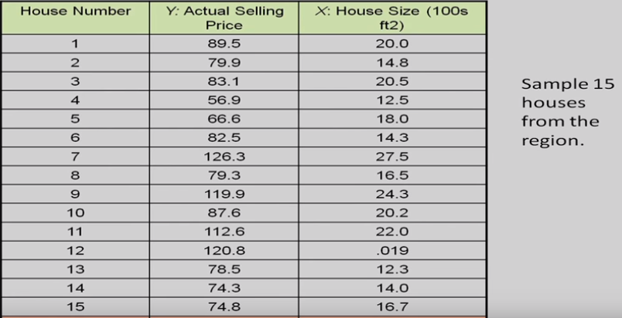

Slide 10
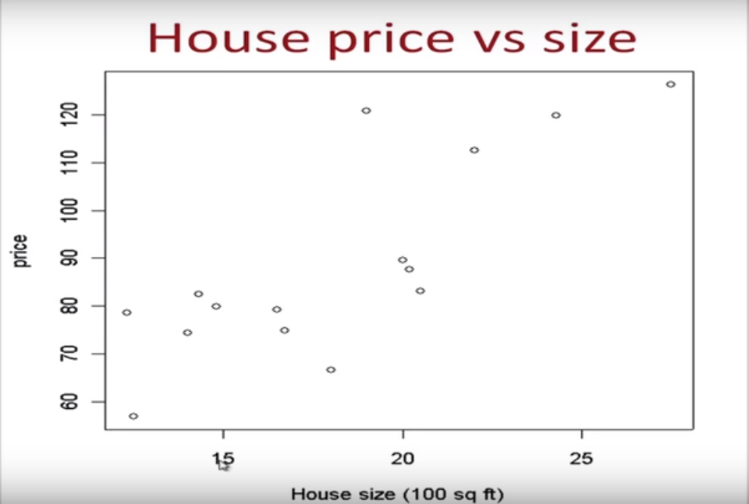

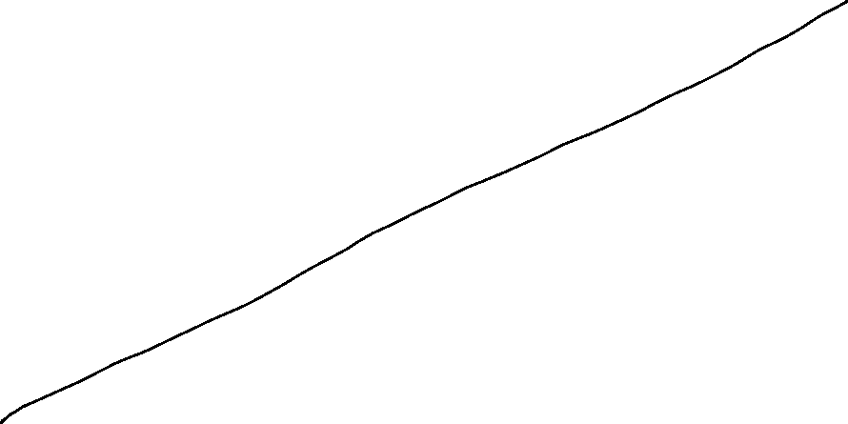


Slide 11
Sample Regression Function
(continued)
Y
Observed Value of y for xi
e_{i}
Slope = b₁
Predicted Value of Y for X_{i}
Random Error for this x value
Intercept = b₀
x_{i}
X

Slide 12
Sample Regression Function
Estimate of the regression intercept
Estimate of the regression slope
Independent variable
Error term
Two parameters to estimate – the slope of the line b1 and the y-intercept b0 (where the line crosses the vertical axis).
e is the unexplained, random, or error component.

Slide 13
The error term (residual)
Represents the influence of all the variable which we have not accounted for in the equation
It represents the difference between the actual "y" values as compared the predicted y values from the Sample Regression Line

Slide 14
Our Objective
To Predict PRL from SRL
From the sample of values of x and y, estimates b0 of β0 and b1 of β1 are obtained using the least squares or another method.
The symbol “^” is termed “y hat” and refers to the predicted values of the dependent variable y that are associated with values of x, given the linear model.

Slide 15
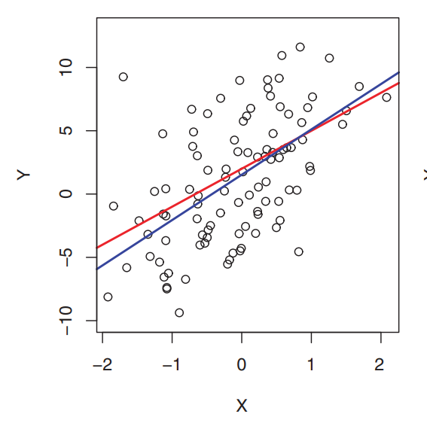
Ordinary Least Squares Estimation
Ordinary least squares (OLS) or linear least squares is a method for estimating the unknown parameters in a linear regression model, with the goal of minimizing the differences between the observed responses and the responses predicted by the linear approximation of the data.
The red line represents the true relationship, f(X)=2+3X, which is known as the population regression line. The blue line is the least squares line; it is the least squares estimate for f(X) based on the observed data, shown in black.

Slide 16
Ordinary Least Squares Estimation
Visually this is seen as the sum of the vertical distances between each data point in the set and the corresponding point on the regression line - the smaller the differences, the better the model fits the data.
b0 and b1 are obtained by finding the values of b0 and b1 that minimize the sum of the squared residuals
Are there any advantages of minimizing the squared errors?
Why don't we take the sum?
Why don't we take absolute values instead?

Slide 17
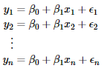
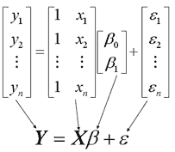
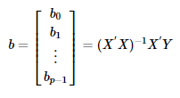
This approach treats the data as a matrix and uses linear algebra operations to estimate the optimal values for the coefficients.

Slide 18
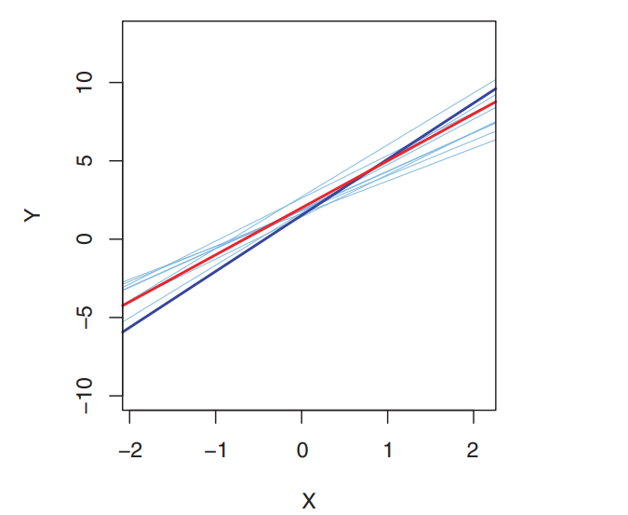
OLS Regression Properties
The sum of the residuals from the least squares' regression line is 0.
The sum of the squared residuals is a minimum.
Minimize ( )
The least squares coefficients are unbiased estimates of β₀ and β₁

Slide 19
Assumptions of Linear Regression
Linearity:- There should be a linear relationship between dependent (response) variable and independent (predictor) variable(s).
Residuals Mean should be equal to zero
No Autocorrelation of residuals:- Error terms should be Independent, i.e. there should be no correlation between the residual (error) terms. Absence of this phenomenon is known as Autocorrelation.
No Multicollinearity:- The independent variables should not be correlated. Absence of this phenomenon is known as multicollinearity.
Equal Variance:- The error terms must have constant variance. This phenomenon is known as homoscedasticity. The presence of non-constant variance is referred to heteroscedasticity.
Normality:- The error terms must be normally distributed.
Note:- If any of the above assumption is not met or violated then the predictions will be incorrect or unreliable

